Slide 1
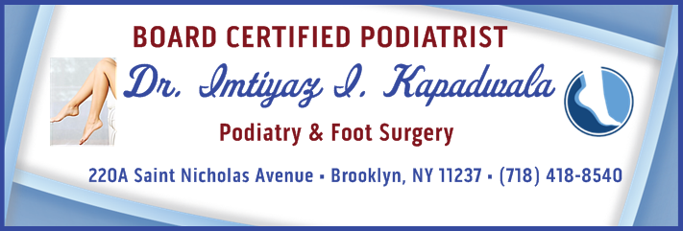

Wound Care in Podiatric Medicine
Doctor’s Name
City, State
Phone Number
Website Address

Slide 2
Types of Wounds
Mechanical–blisters, corns, calluses
Diabetic ulcer
Vascular/Gangrene
Trauma (accident)

Slide 3
Mechanical–Blisters, Corns, and Calluses
Blisters and calluses should never be considered benign skin lesions, especially in immuno-compromised patients
Treatment for blisters:
  Drain the fluid but leave the skin intact
Treatment for corns/calluses:
  Routine debridement
Prevention:
  Use of adhesive gel pads, foot powders, special socks

Slide 4
Diabetic Ulcer
Diabetic ulcer–An open sore or wound that most commonly occurs on the foot
Causes:
  Elevated blood glucose
  Neuropathy
  Uncontrolled blood pressure
  Poor nutrition
  Prolonged pressure

Slide 5
Vascular/Gangrene
Gangrene occurs when tissue dies (necrosis) because its blood supply is interrupted. Gangrene may be caused by an infection or injury, or be a complication of a long-term condition that restricts blood circulation.

Slide 6
Trauma (Accident)
High-velocity blunt trauma
Low-velocity blunt trauma
High-velocity penetrating trauma
Low-velocity penetrating trauma
Thermal/Chemical injuries

Slide 7
Treatment/Prevention
Nutritional support
Debridement
Orthotic supports
Off-loading
Wound V.A.C. system
Skin grafts (autografts and allografts)
Flowable soft tissue scaffold
Topical wound-healing agents

Slide 8
Nutritional Support–Protein
Protein deficiency is a major factor in the healing of ulcers.
Protein is necessary for fibroblast proliferation, new blood vessel formation, and collagen production.
Depending on the severity of the wound, protein consumption should range from 0.55 to 0.84 grams per pound of body weight per day.
Consult a nutritionist for the proper amount of protein consumption.

Slide 9
Nutritional Support
Vitamins/Minerals
Vitamin A–Increases collagen synthesis and wound tensile strength along with lymphocyte activation
Vitamin C–Increases skin strength and fibroblastic content of scar tissues
Vitamin E–Anti-inflammatory action decreases the production of prostaglandins
  Enhances the immune response and breaking strength of post-operative wounds
Zinc–Stimulates wound healing and increases collagen tensile strength

Slide 10
Debridement
Goals of debridement:
  Remove potential pathogens
  Remove necrotic and fibrous infiltrates

Slide 11
Debridement
Forms of Debridement:
  “Cold steel”–scalpel, curette, rongeur, tissue nippers
  Mechanical–wet to dry dressings, pulse lavage
  Enzymatic debridement

Slide 12
Wound V.A.C. System
Goals of V.A.C. System:
  Promote granulation and tissue perfusion
  Remove infectious material
  Draw wound edges together
Applications:
  Diabetic wounds
  Pressure ulcers
  Skin grafts
  Infected wounds

Slide 13
Skin Grafts–Autografts
Traditional Skin Graft:
  Tissue usually removed from the thigh, leg, or buttocks on the same person
Glabrous Skin Graft:
  Tissue usually removed from the medial arch of the foot
  Replace “like” with “like”

Slide 14
Skin Grafts–Allografts
Tissue removed from one person and transplanted to another person
Closes a wound by providing a barrier against infection and fluid loss
Reduces pain and promotes the healing of underlying tissues

Slide 15
Skin Grafts–Allografts
Dermagraft
  Dermal substitute
  Utilization—promote granulation and the
  “filling” of the wound bed
  Derived from fetal foreskin
Apligraft
  Epidermal/dermal bi-layer
  Utilization—promote granulation and
  epithelialization
  Derived from fetal foreskin
Graft Jacket/Theraskin
  Epidermal/dermal bi-layer
  Utilization—promotes epithelialization
  Derived from fetal cadaveric donors

Slide 16
Flowable Soft Tissue Scaffold
Tissue scaffold is a soft tissue graft (reconstituted in the OR), which is comprised solely of human dermal tissue, including its native protein and collagen structure
Provides rapid granular tissue formation to fill tunneling or undermining wounds

Slide 17
Topical Wound Healing Agents
Dressings (anti-microbial dressings)
  If it is dry, make it wet
  If it is wet, make it dry
Gels/Ointments
  Provide a protective, hydrating, and lubricating layer over the wound that promotes healing

Slide 18
QUESTIONS?
For more information, contact our office:
Dr. Imtiyaz I. Kapadwala
The Leg, Foot & Ankle Center of Brooklyn
220A Saint Nicholas Ave. Brooklyn, NY 11237
Tel: 718-418-8540
www.BrooklynFootSurgery.com

