Slide 1
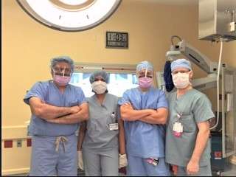

PODIATRIC SURGERY
Dr. Imtiyaz I. Kapadwala
The Leg, Foot & Ankle Center
220A Saint Nicholas Ave. Brooklyn, NY 11237
Tel: 718-418-8540
www.BrooklynFootSurgery.com
Notes:
There are different directions that you can use this powerpoint, and it will be dependent on your audience.
This can serve as a guide; however, because of the number of procedure techniques, it can also be broken into various individual presentations.
You would want to pick and choose the common procedures in your practice and highlight a case of your own.

Slide 2
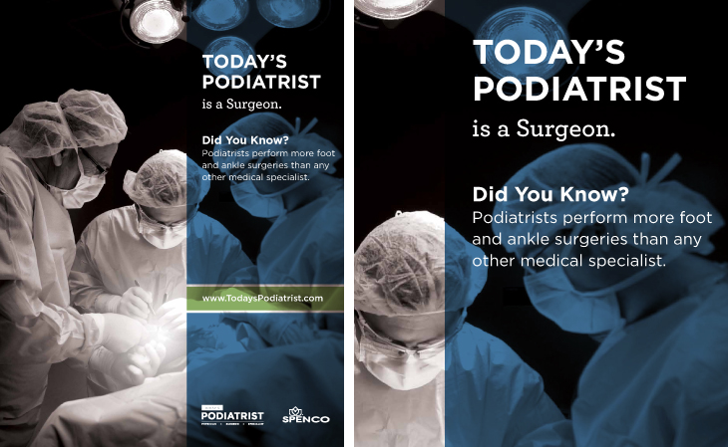
Notes:
Today’s Podiatrist is a Surgeon – performing more foot and ankle surgeries than any other medical specialist

Slide 3
DECISION MAKING
Indications
Contraindications
Pre-operative Consult
  Medical Clearance
  Surgical Consent
Post-operative Care
Rehabilitation

Slide 4
TYPES OF SURGERY
Biopsies
Excisions
Grafting
Nail Surgery
Forefoot
Rearfoot
Reconstructive
Tendon Procedures
Trauma
Ankle Procedure

Slide 5
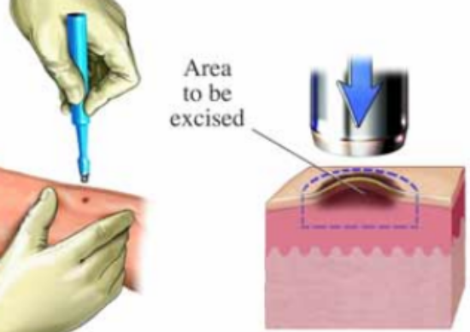
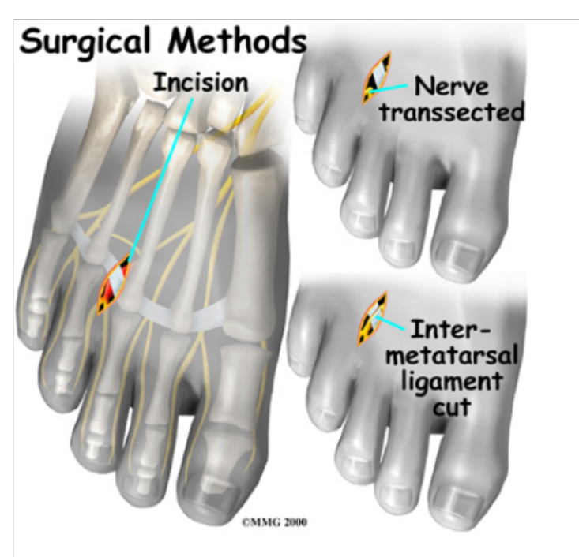
BIOPSIES/EXCISIONS
Nail Plate
Skin Lesions
  Pigmented Lesions
  Keloids
  Soft Tissue Masses
Tumors
  Granulomas
  Fibromas
  Neuromas
Muscle Biopsy
Bone Biopsy

Slide 6
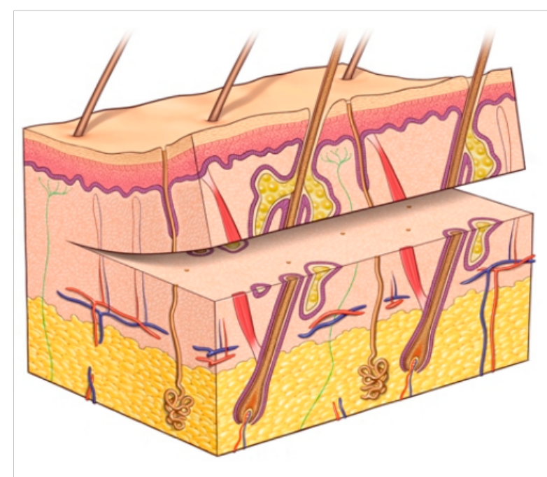
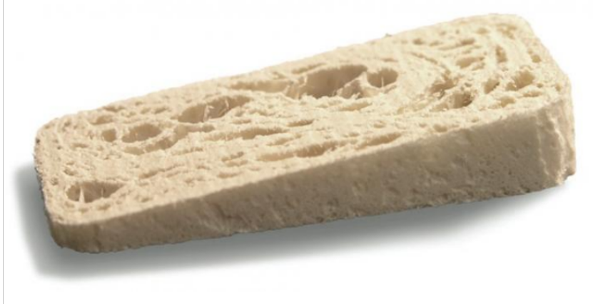
GRAFTING
Skin Grafting
  Split Thickness
  Full Thickness
Bone Grafting

Slide 7
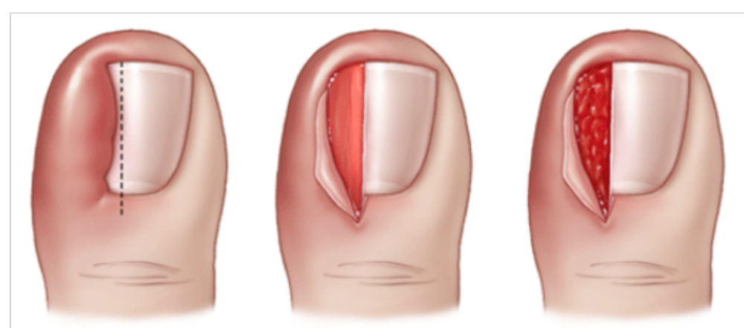
NAIL SURGERY
Indications/Contraindications
Nail Avulsions
Wedge Resection
Nail Matrixectomies

Slide 8
COMMON FOREFOOT SURGERY
Nail Surgery
Neurectomy
Hallux Deformities
  Hallux Valgus
  Hallux Limitus
Toe Deformities
  Hammertoes

Slide 9
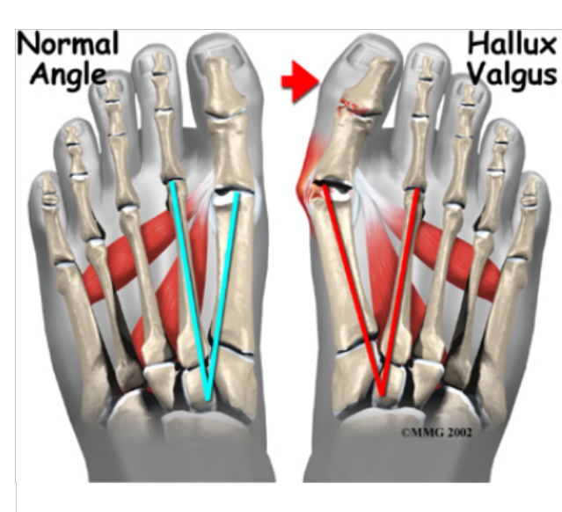
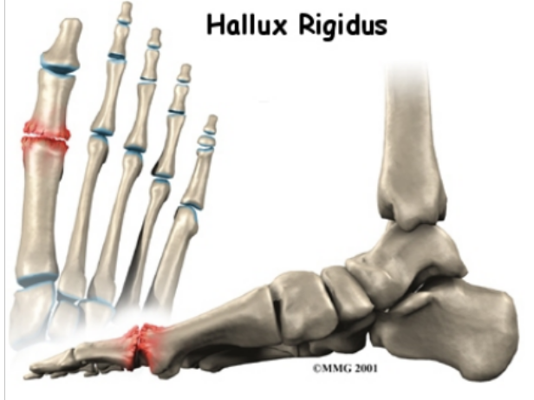
FOREFOOT SURGERY
Indications/Contraindications
Hallux Valgus (Bunion)
  Capsule/Tendon Balance
  Phalangeal Osteotomy
  Metatarsal Osteotomy
    Head
    Midshaft
    Base
Hallux Varus
Hallux Limitus/Rigidus
  Chilectomy
  Arthroplasty
  Arthrodesis
  Wedge Ostetomy

Slide 10
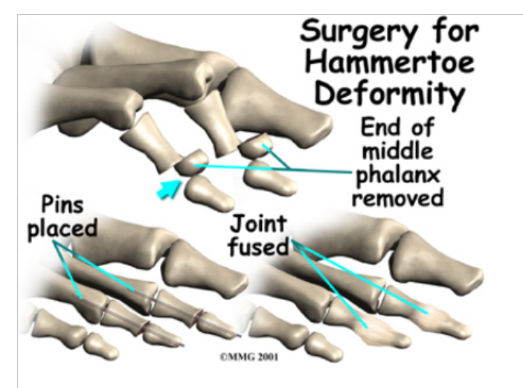
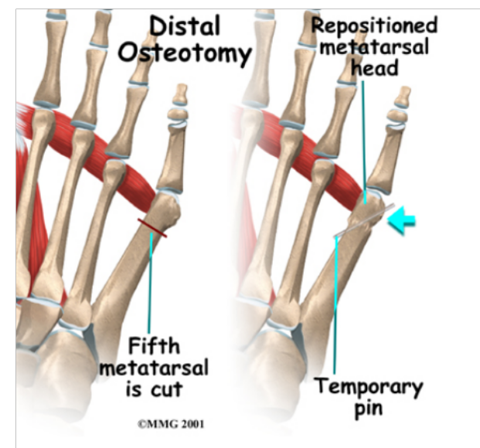
TOE DEFORMITIES
Indications/Contraindications
Hammertoe/Mallet Toe/Claw Toe
  Soft tissue release
  Arthroplasty
  Arthrodesis
  Special Deformities
    Dorsal Dislocation with Hammertoe
    Crossover Toe
5th Digit
  Cock-up deformity
  Congenital varus (Curly Toe)
Tailor’s Bunion/Bunionette
  Capsule/Tendon Balance
  Osteotomy

Slide 11
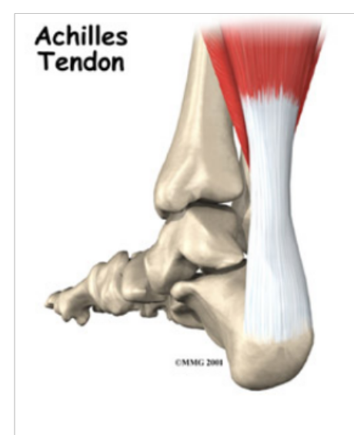
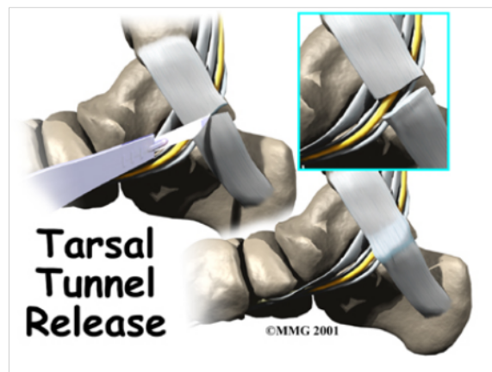
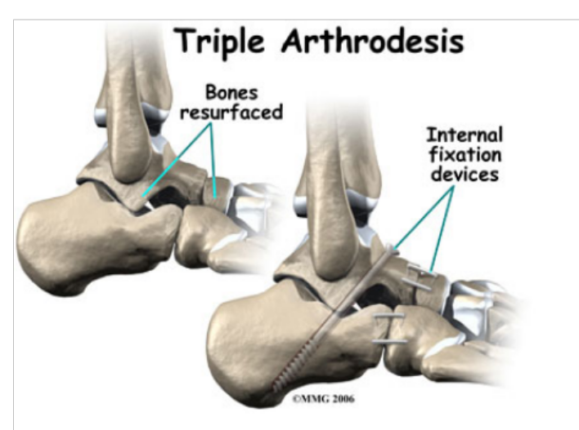
REARFOOT SURGERY
Indications/Contraindications
Soft Tissue Procedures
  Plantar Fascia Release
  Nerve Decompression
    Tarsal Tunnel Release
  Achilles Tendon
    Repair
    Lengthening
Calcaneal Ostectomy and Osteotomy
Arthrodesis
  Isolated joint Arthrodesis
  Subtalar Arthrodesis
  Triple Arthrodesis

Slide 12
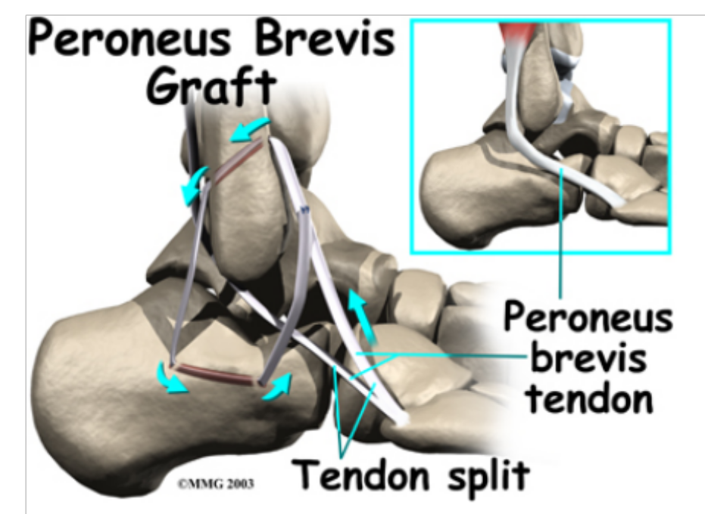
TENDON PROCEDURES
Indications/Contraindications
Posterior Tibial Tendon Dysfunction
Chronic Ligament Instability

Slide 13
TRAUMA
Indications/Contrindications
Fractures
  Forefoot
    Sesamoids
    Phalanges
    Metatarsals
    5th Metatarsal
  Midfoot
    LisFranc Injury
    Navicular/Cuboid
  Rearfoot
    Talus
    Calcaneus
Incision & Drainage
Compartment Syndrome
Amputation
Ankle Fractures
Pilon Fractures

Slide 14
SPECIAL PROCEDURES
Reconstruction
  Brachymetatarsia
  Rheumatoid Foot
  Tarsal Coalition
  Charcot Foot
Scope Procedures
  Endoscopic Neurolysis
  Endoscopic Plantar Fasciotomy
  Ankle Arthroscopy

Slide 15
SURGERY GOALS
Prevent Infection
Reduction of Pain
Reduction of Deformity
Return to Function

Slide 16
FOR MORE INFORMATION contact www.APMA.org
Dr. Imtiyaz I. Kapadwala
The Leg, Foot & Ankle Center
220A Saint Nicholas Ave. Brooklyn, NY 11237
Tel: 718-418-8540
www.BrooklynFootSurgery.com

